Slide 1

gENETIC algorithm
Exploring the Power of Evolutionary Computing
Notes:
Umer

Slide 2

INTRODUCTION
Welcome to our exploration of Genetic Algorithms (GAs), a computational methodology inspired by the principles of natural selection. Today, we'll examine the practical applications and fundamental components that make GAs a valuable tool in optimization.
Notes:
Umer

Slide 3

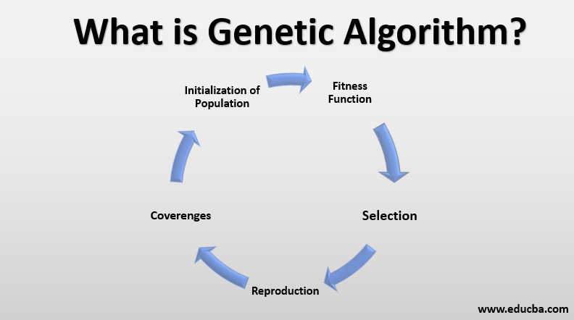
What are GeneTic Algorithms?
Genetic Algorithms emulate natural selection processes to navigate solution spaces efficiently. Drawing inspiration from Darwinian evolution, GAs utilize selection, crossover, and mutation to iteratively refine solutions
In addressing complex problems, GAs offer a pragmatic alternative, excelling in scenarios where traditional algorithms encounter challenges. Their adaptability and efficiency make them particularly relevant in optimization tasks.
General Applications for GA’s include
Optimization Problem
Combinatorial Optimization
Machine Learning
Financial Modeling
AND MUCH MORE!
Notes:
Umer

Slide 4

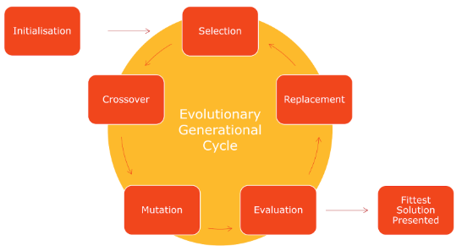
The general layout of how a genetic algorithm works
Create initial batch (Initialization)
Test the Batch in terms of performance (Selection)
Take the highest scorers and breed them to make new batch (Crossover)
Mutate members of the Batch (Mutation)
Compare the Batch to the task it is assigned to complete (Evaluation)
If the Batch is not up to the standards repeat the Cycle (Replacement)
Repeat Until the Batch is proficient enough (Fittest Solution)
Notes:
Arno

Slide 5
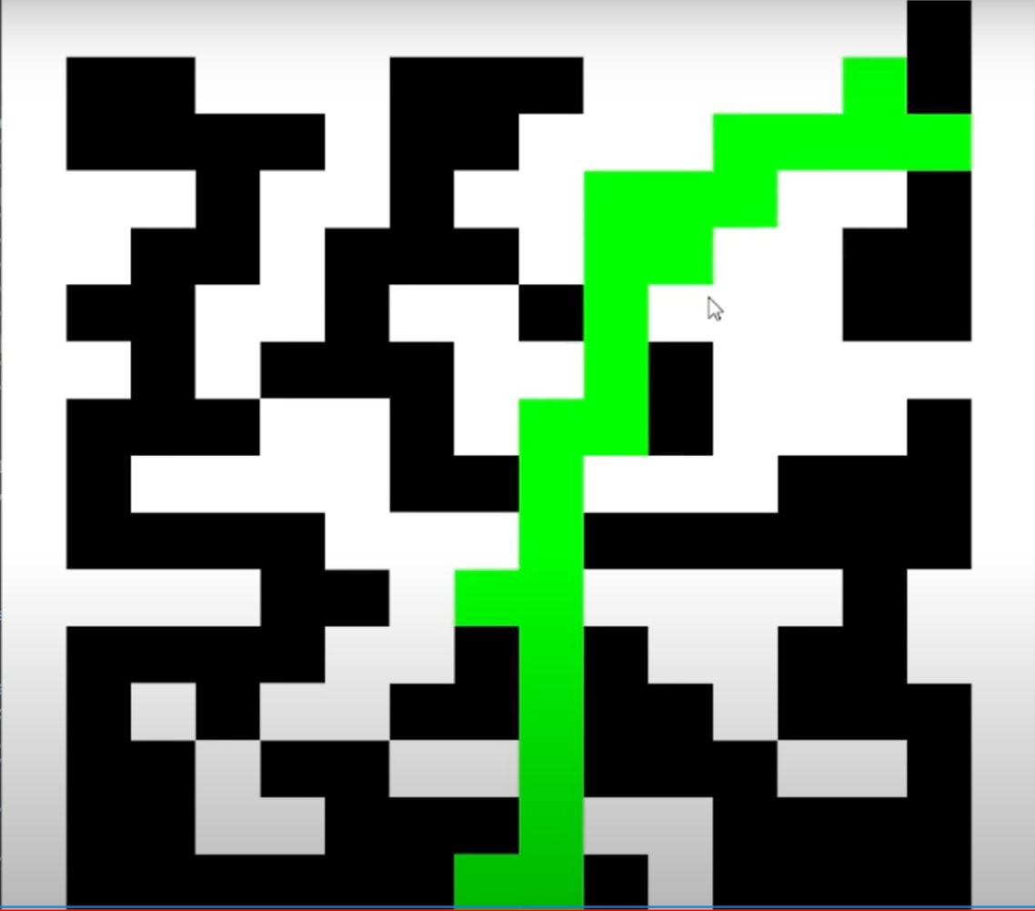
Create initial batch
Depending on what the task is this could look
different one example would be trying to make
an algorithm to finish a maze
To start make 32 characters make them do
2 moves which are each randomly assigned
(up, down, left or right)
Notes:
Arno

Slide 6

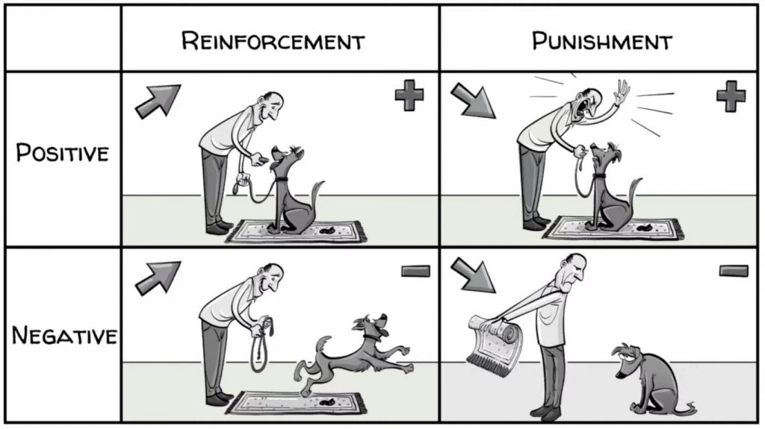
Testing and scoring
To test them, run each member of the batch with 2 moves.
Depending on the results on their two moves, they will be punished or rewarded.
Scoring System
Hitting a wall -1 Point
Going into an empty space is +1 point
Going up or right (the exit is up and to the right) +2 points
Notes:
Arno

Slide 7


Breeding the best (Crossover)
In order to ensure that the algorithm can solve the maze, we utilize the attributes of the best of each generation. We analyze which members have the highest points and use their moves to generate an offspring.
This draws on the idea of Survival of the Fittest, where the best of each generation will live on an reproduce the best over and over again.
There is no upper limit to the number of best parents,
if many parents are tied for their points we simply use all of them!
Notes:
Arno

Slide 8

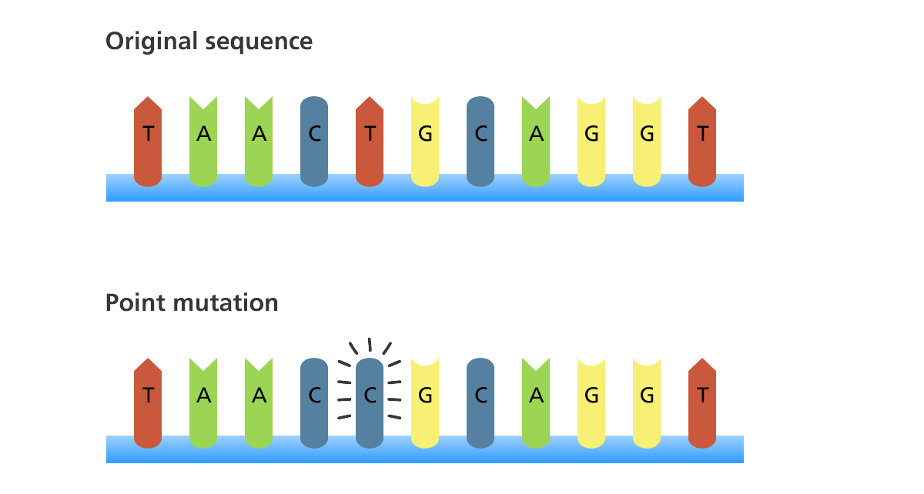
Mutation
In our example, half of a new generation will have mutations which will affect their direction.
Though it may initially be thought of as a hindrance, mutations are extremely useful for when a generation gets stuck on a problem.
Notes:
Arno

Slide 9

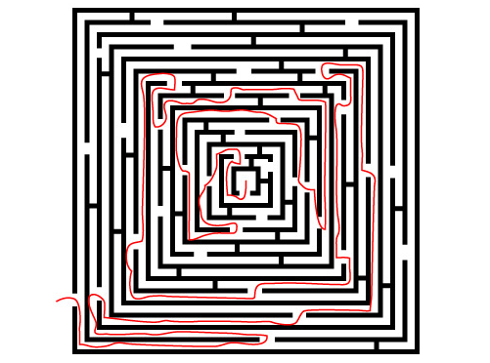
Saving the good one
We rinse and repeat all of the prior steps, until we reach a member that has finished the maze.
Once a member has finished the maze, we give it +1000 point to indicate that he was the most successful.
Thus the algorithm is complete and we have a bot that
Can solve the maze!
Notes:
Arno

Slide 10

Example video!
Here is a time lapse video of a genetic algorithm we created to solve a maze we created
Notes:
Ethan

Slide 11

Example video!
Here is a time lapse video of a genetic algorithm we created to solve a maze we created

Slide 12

Pros | cons
Adaptability: Dynamically adjusts solutions for complex problems. Parallel Processing: Efficiently explores multiple solutions simultaneously. Speed Efficiency: Demonstrates fast convergence, especially in large solution spaces. | Limited Constraint Handling: Struggles with complex constraint management. Not Ideal for Simplicity: Overkill for straightforward optimization problems. Parameter Sensitivity: Requires careful tuning, sensitive to parameter choices.
Notes:
Abinav

Slide 13
conclusion
In summary, Genetic Algorithms provide a practical lens through which we can address optimization complexities. This computational approach, grounded in evolutionary principles, offers valuable insights for problem solvers.
Notes:
Abinav

